Slide 1

DISEASE PREDICTION BASED ON BREAST CANCER
Sowmya Nuchu
Jinal Patel

Slide 2

Benign Tumor
Not Cancerous
Slow growing cells
Do not spread to other tissues
Do not revert back once it is cured
Malignant Tumor
Cancerous
Rapidly growing cells
Can spread to other tissues
May revert back once it is cured
Goal : Based on the cells present in our body our goal is to predict whether that the tumour detected is malignant and benign tumor

Slide 3
PROJECT WORK FLOW
Impute
If available
Read Dataset
Pre-Process Data – Checking for missing values
Visualize Data
Changing categorical variables into numerical variables
Model Evaluation
Applying ML algorithms
Splitting data into training data and test data

Slide 4
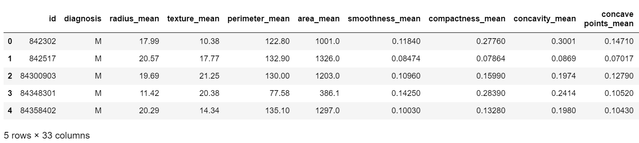
PREPARING DATA
The preparation and pre-processing of the data is the first step in any machine learning procedure. In general, machine learning algorithms cannot work with missing values, so before launching one, the dataset must be cleaned up by removing features that have no bearing on the model. In this case we are removing the id and unnamed field as it will not be used in categorization process

Slide 5
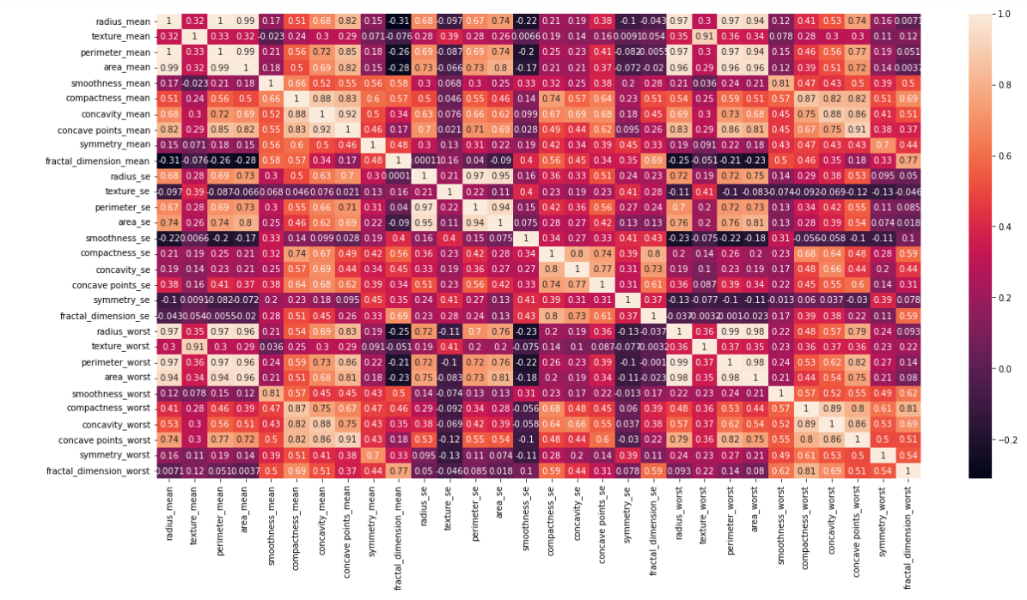
DATA VISUALIZATION
We need to build visualizations of the data in order to decide how to proceed with the machine learning tools.
Heat maps is the first technique that is utilized for visualization. A heat map is a two-dimensional visualization of data .With the help of heatmap users can comprehend complex data sets with the help of more intricate heat maps.

Slide 6
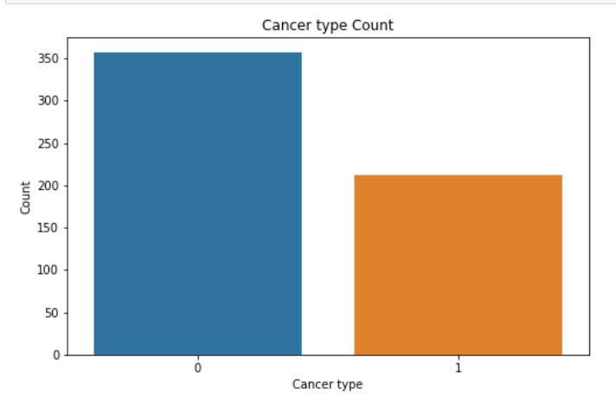
Pair Plot
We can also see how the malignant or benign tumors cells can have (or not) different values for the features plotting the distribution of each type of diagnosis for each of the mean features.
Count Plot
We can plot a seaborn count plot displaying the frequency of both categories of the target variable. We observe that category M, or malignant, has a frequency of 212 while category B, or benign, has a frequency of 357.

Slide 7
MACHINE LEARNING ALGORITHMS
Decision Tree Classifier
Random Forest Classifier
KNN
Support Vector Machine

Slide 8
EVALUATION AND COMPARISON OF ALL THE MODELS
Evaluating the machine learning model is a crucial part in any data science project. There are many metrics that helps us to evaluate our model accuracy.
Classification Accuracy
Confusion matrix
Precision
Recall
Classification_report
ROC AUC Score

Slide 9
PRECISION & RECALL
Precision : It is the ratio of correctly predicted positive observations to the total predicted positive observations.
Precision= TP/(TP+FP)
Algorithms | Precision | Recall
KNN | 0.90 | 0.978261
SVM | 0.94 | 1.000000
Random Forest | 0.94 | 0.958333
Decision Tree | 0.92 | 0.849057
Recall : is the ratio of positive instances that are correctly detected by the classifier to the all observations in actual class
Recall = TP/(TP+FN)

Slide 10
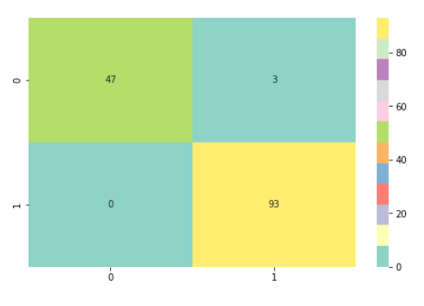
CONFUSION MATRIX
A confusion matrix is a table that can be used to measure the performance of a machine learning method, usually a supervised learning one.
True Positive(TP) : predicted as yes(Healthy), and is actually yes(Healthy).
True Negative(TN): predicted as not(Cancer), and is actually no(Cancer).
False Positive(FP): predicted as yes(Healthy), but actually no(Cancer).
False Negative(FN): predicted as no (Cancer), but actually yes(Healthy).
NOTE: For this dataset, whenever the model is predicting something as yes, it indicates Absence of cancer cells (Healthy) and for cases when the model predicting no; it indicates existence of cancer cells(Cancer).

Slide 11
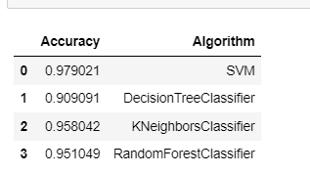
ALGORITHMS ACCURACY
Upon applying supervised algorithms we found out that , the SVM classifier is being proved more efficient and accurate for the prediction and classification of the tumor as malignant (cancerous) or benign (non-cancerous).

Slide 12
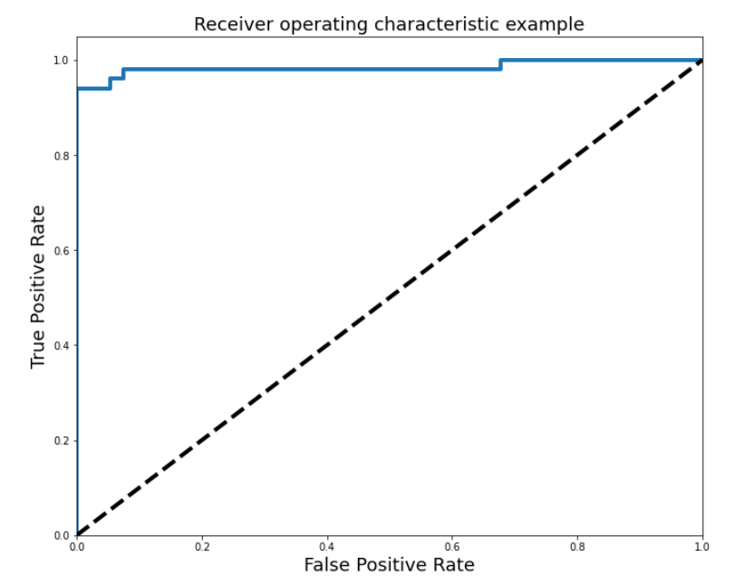
ROC CURVE
The ROC curve shows the trade-off between sensitivity (or TPR) and specificity (1 – FPR). As we notice the SVM Classifier give a curve closer to the top-left corner so it indicate a better performance.

Slide 13
THANK YOU !

